Slide 1

Initial presntaion
Arabic Sentiment Analysis

Slide 2
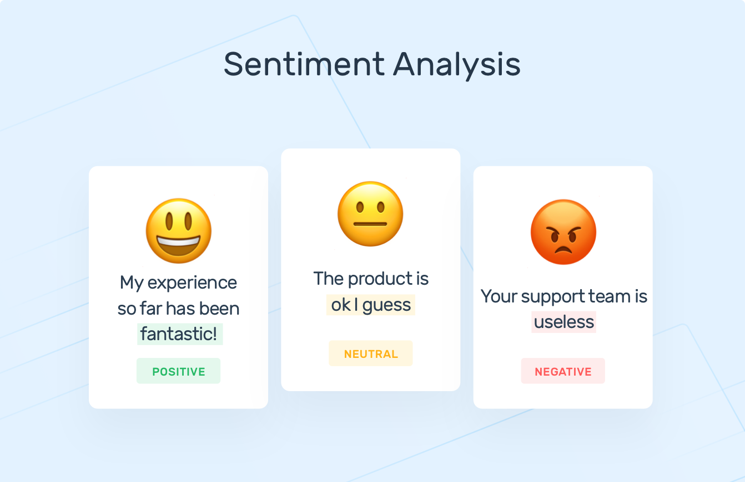
Introduction
Sentiment Analysis indicate the use of Natural Language Processing (NLP) and Machine Learning to specify and extract subjective information in a piece of text. Sentiment Analysis is powerfully useful as it enables us to obtain an overview of the wider public opinions (e.g., happy, sad, and anger) towards certain topics, products or services.

Slide 3
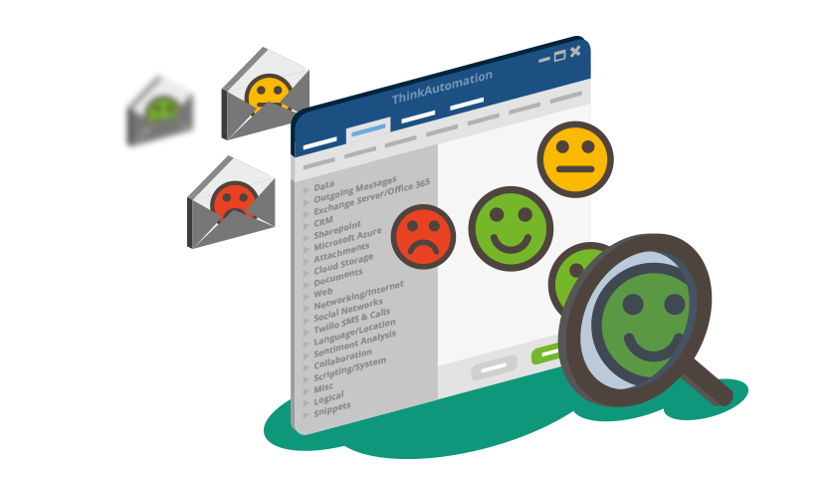
Project aim
The aim of this project is to develop a software system that analyzes a vast amount of texts from various sources by analyzing each review sentence with a focus on specific aspects and use or specific keywords it will help people in determining the best decision making towards certain topics, products or services.

Slide 4
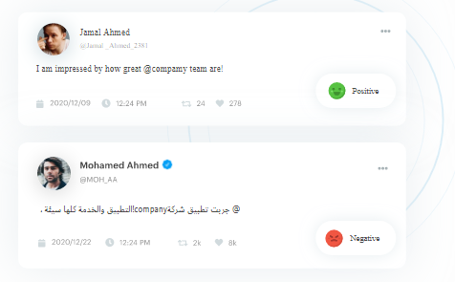
Importance of Sentiment Analysis for Arabic language
Sentiment Analysis is important for the Arabic language, which suffers from a lack of interest in terms of applications of artificial intelligence, including machine learning and deep learning. As there is no scientific research so far has monitored and obtained findings on the processing levels of the Arabic language at a high and comprehensive level.

Slide 5
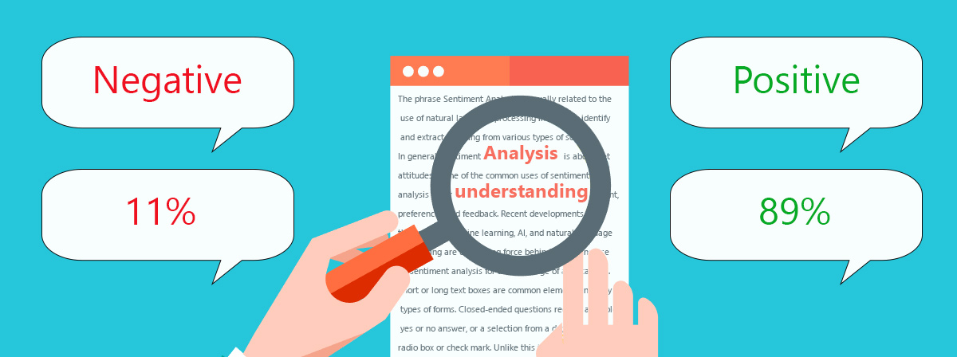
What is Sentiment Analysis ?
It is the process of determining the emotional tone behind a series of words, used to gain an understanding of the attitudes, opinions and emotions expressed within an online mention.

Slide 6
ML Archeticture
Data preprocessing
Training
Testing
Convert text to numaric values

Slide 7

Data preprocessing
Normalization
Data cleaning
Balance the data
…..etc.

Slide 8
Text Numeric Values
Count Vectorizer
1-gram
2-gram
3-gram
TFIDF
1-gram
2-gram
3-gram

Slide 9
ML algorithms in training phase
Support vector machine
Logistic regression
Random forest
Naïve bayes

Slide 10

Refrences
[ Mohammad S. Hasan , Shahnoor C. Eshan ] , An application of Machine Learning to Detect Abusive Bengali Text (paper)
[Anjuman Prabhat , Vikas Khullar ], Sentiment classification on Big Data using Naïve Bayes and Logistic Regression (paper)

Slide 11
milestones
Initiating
Requirments
planing
Chose data sets
Training over experiments
closing
Write final report
Define goals
Chose the text to numbers algorithms
Chose machine learning algoritms
Testing
Desighning GUI
Excuting
Data preprocessing

Slide 12
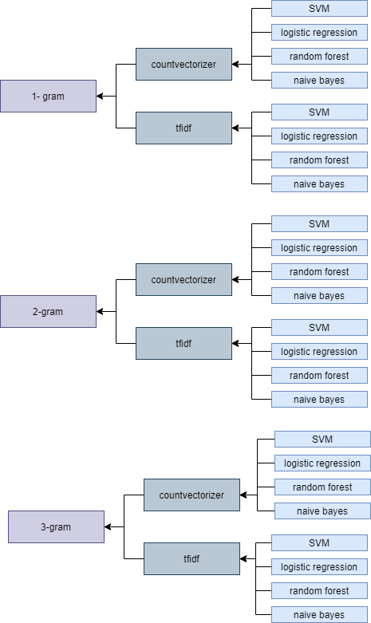
Experiments
End with 24 experiments

Slide 13
Deliverable
Project report
GUI app

Slide 14
Data set
We used different data set in our project that include different reviews:
- Attraction Reviews
- Hotel Reviews
- Movie Reviews
- Product reviews
- Restaurant reviews
Consist of number of examples for each class: Positive, Negative, and Neutral.

Slide 15
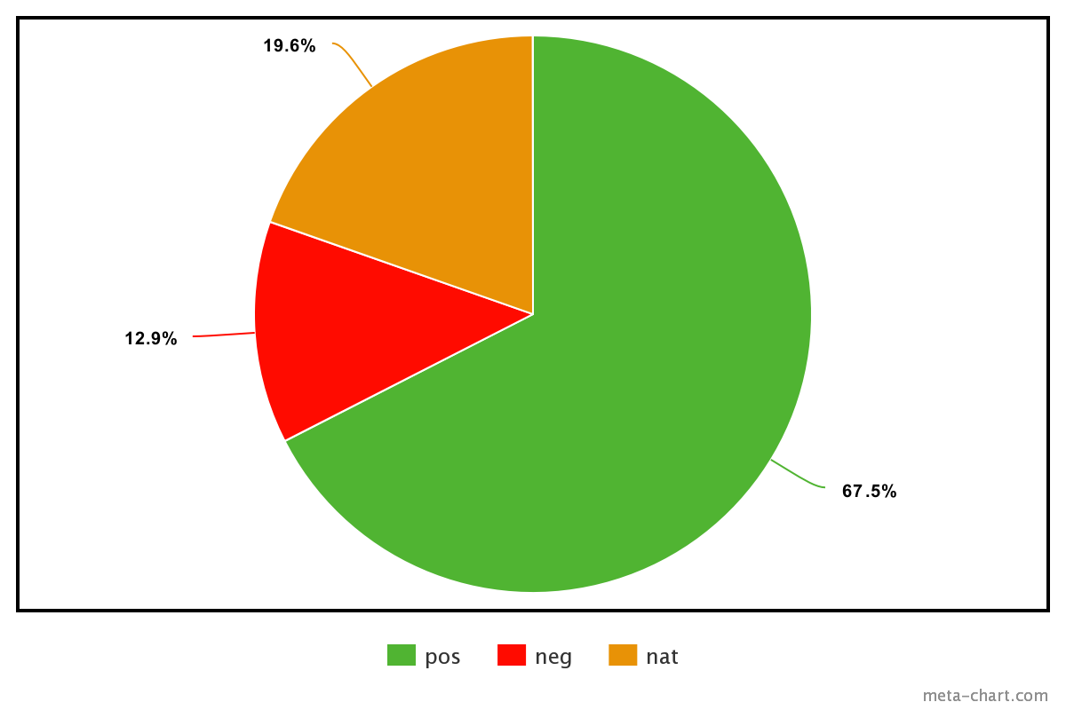
Hotel reviews (unbalenced)
Source: booking.com
Positive : 276387
Negative : 52849
Natural : 80326
Total 409562 record

Slide 16
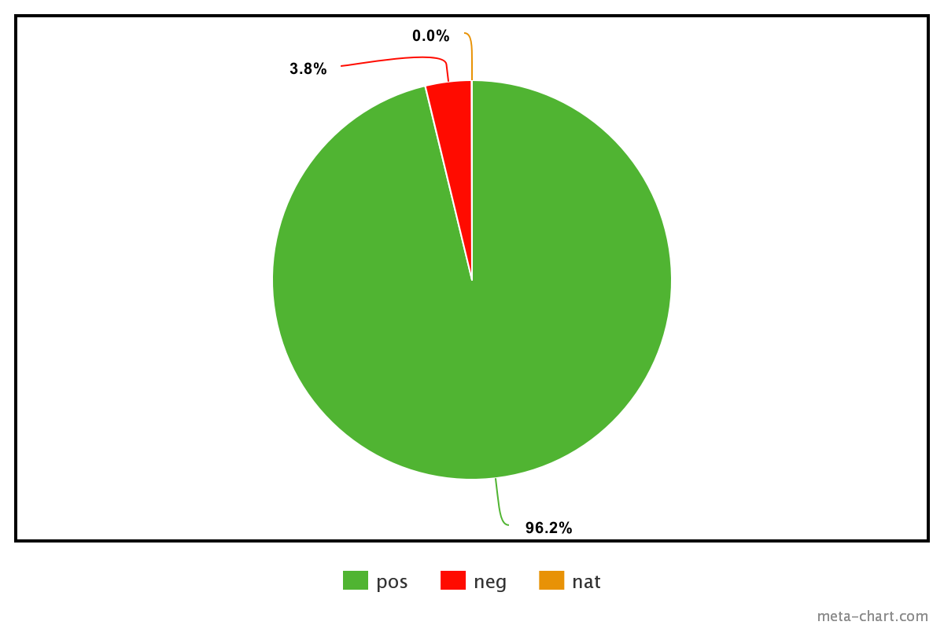
.
Attraction reviews (unbalenced)
Attraction reviews Data set from tripadvisor.com
Positive : 2073
Negative : 81
Natural : 0
Total 2154 record

Slide 17
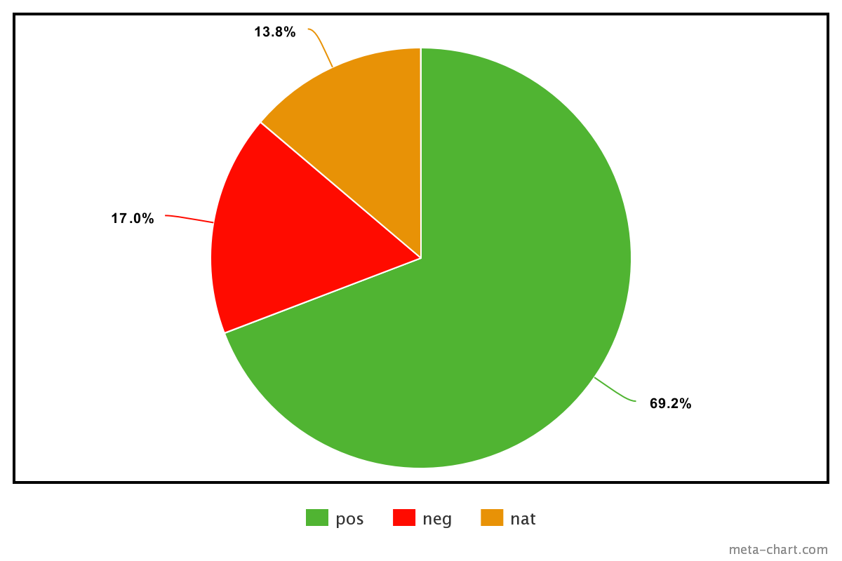
Hotel reviews (unbalenced)
Hotel reviews data set from tripadvisor.com
Positive : 10775
Negative : 2647
Natural : 2150
Total 15572 record

Slide 18
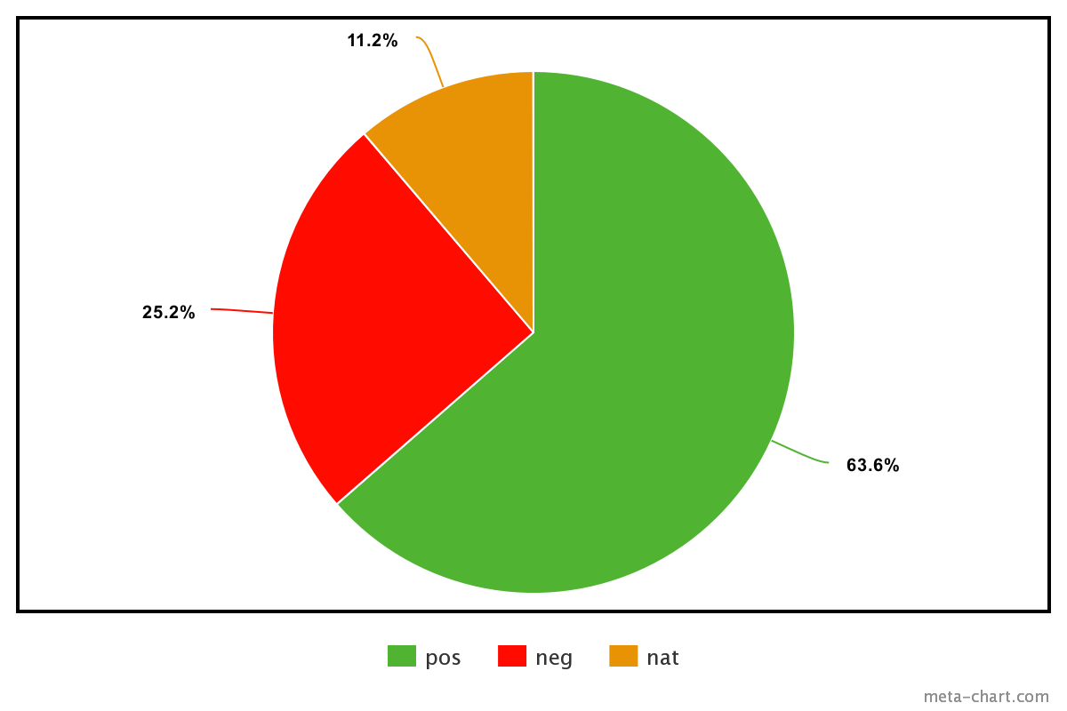
Movie reviews (unbalenced)
Movie reviews data set from elcinema.com
Positive : 969
Negative : 384
Natural : 171
Total 1524 record

Slide 19
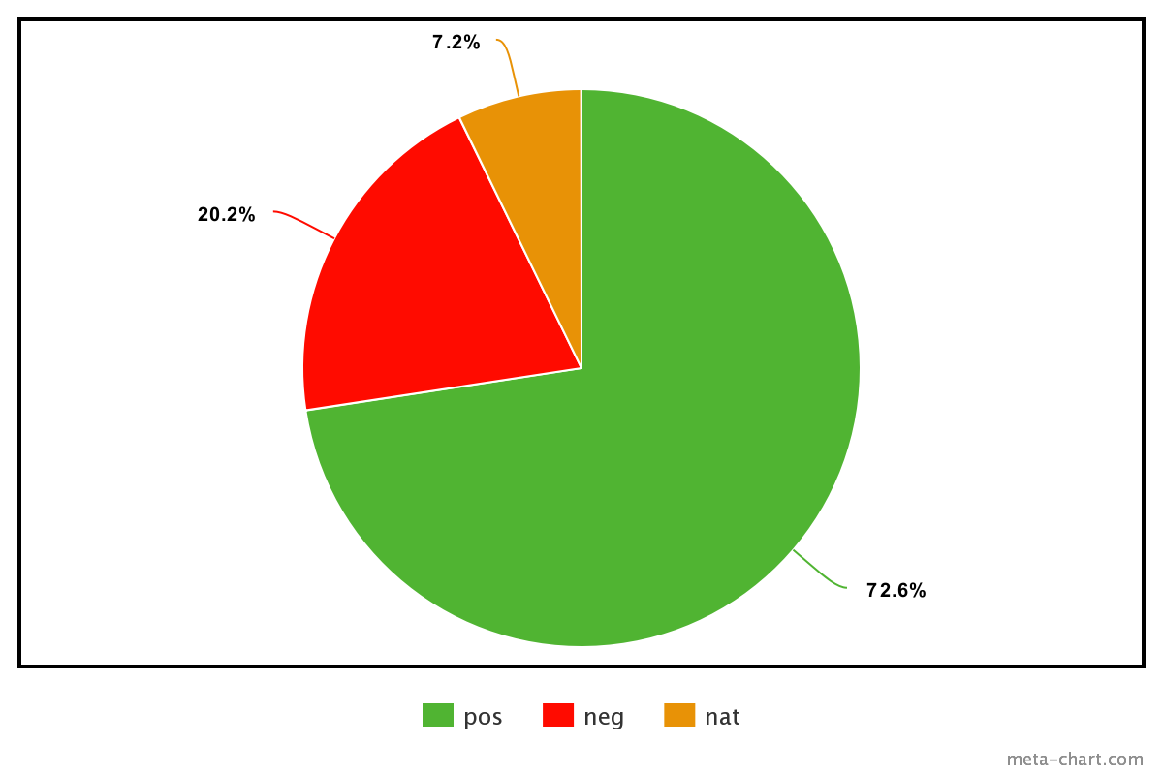
Products reviews (unbalenced)
Products reviews data set from souq.com
Positive : 3101
Negative : 863
Natural : 308
Total 4272 record

Slide 20
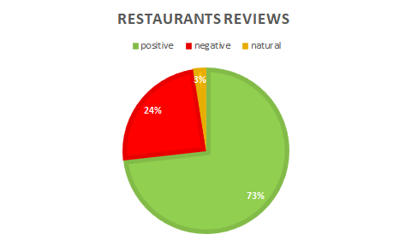
Restaurants reviews (unbalenced)
Restaurants reviews data set from qaym.com and tripadvisor.com
Positive : 8030
Negative : 2675
Natural : 265
Total 10970 record

Slide 21


APIs we needed for analaysis
Scikits-learn : free software machine learning library for the Python programming language.
- Tfidfvectorizer class
- CountVectorizer class
Pandas: Software library written for the Python programming language for data manipulation and analysis.

Slide 22


